Slide 1
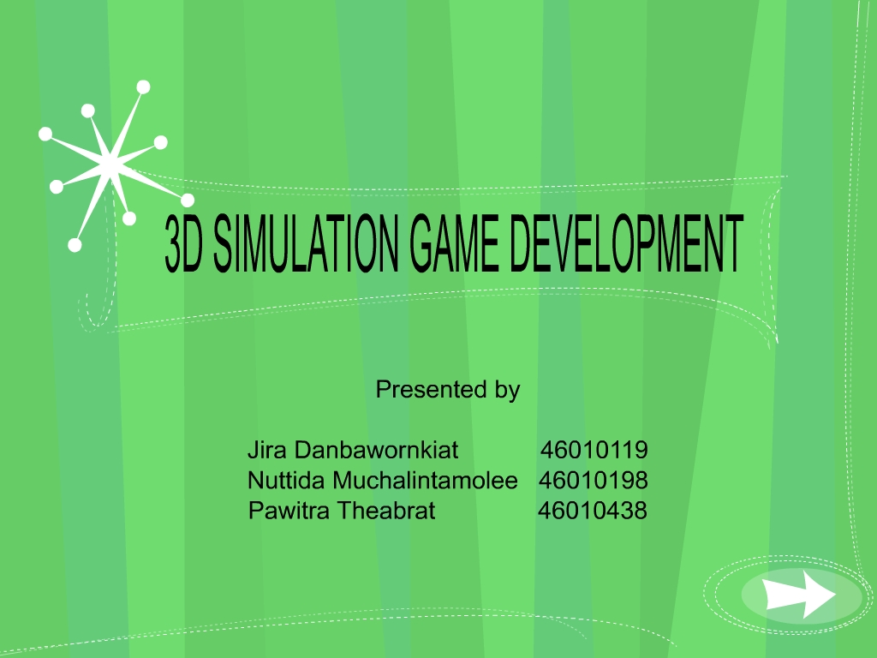
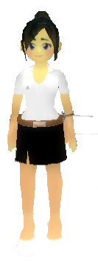

Slide 2
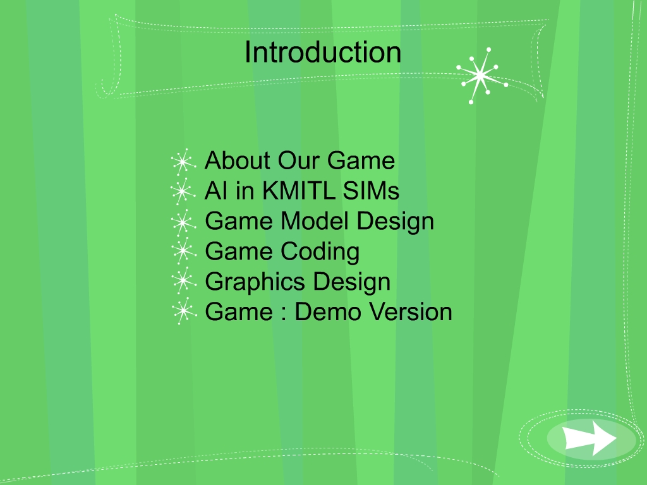
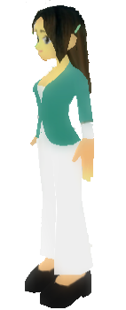

Slide 3
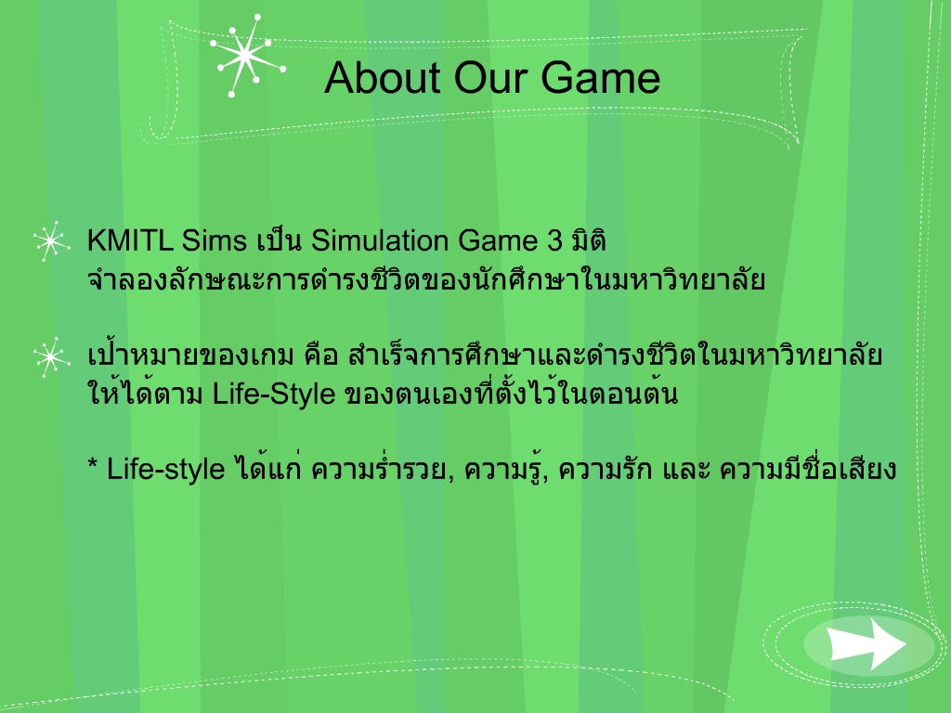

Slide 4
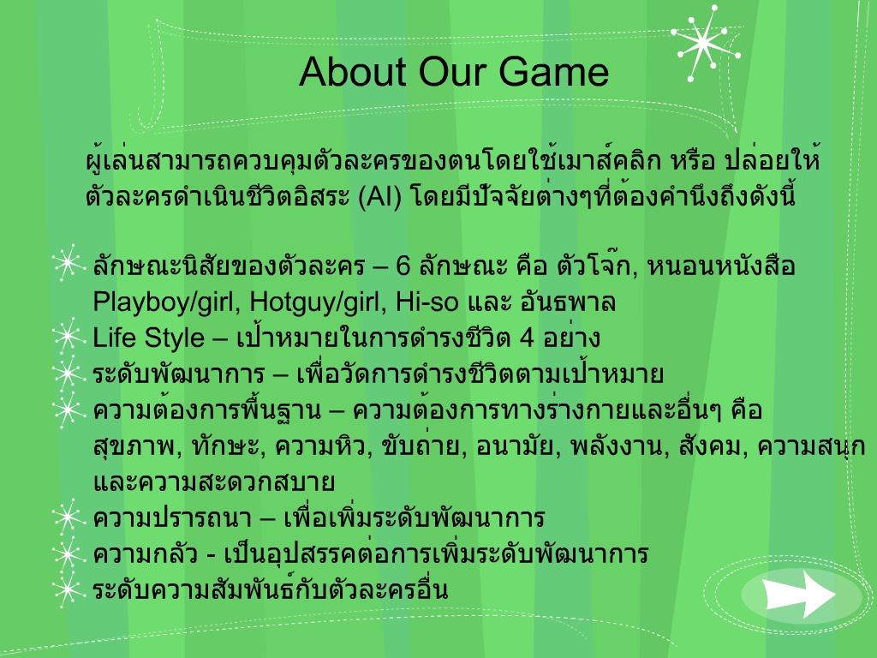

Slide 5
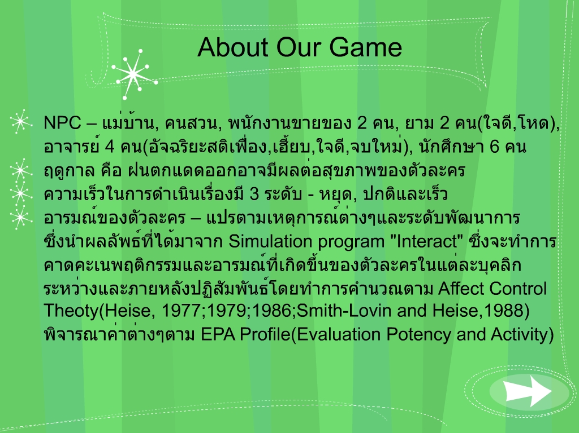

Slide 6
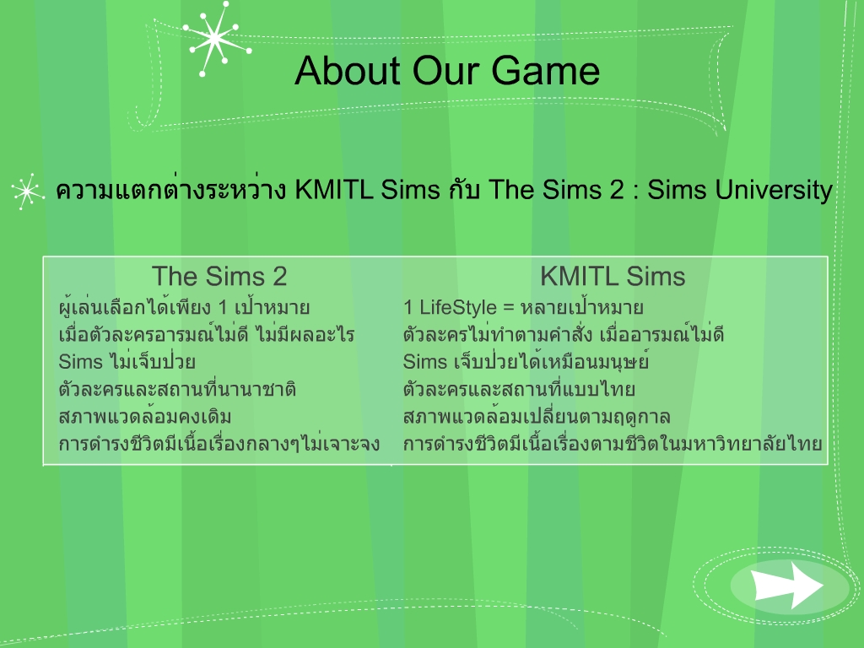

Slide 7
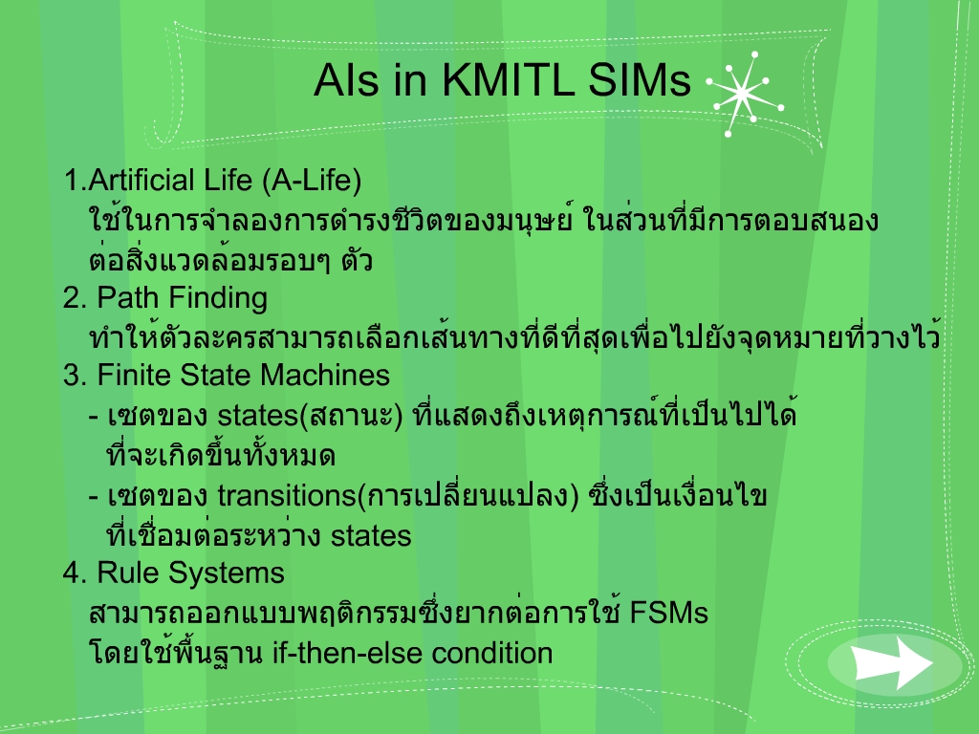

Slide 8

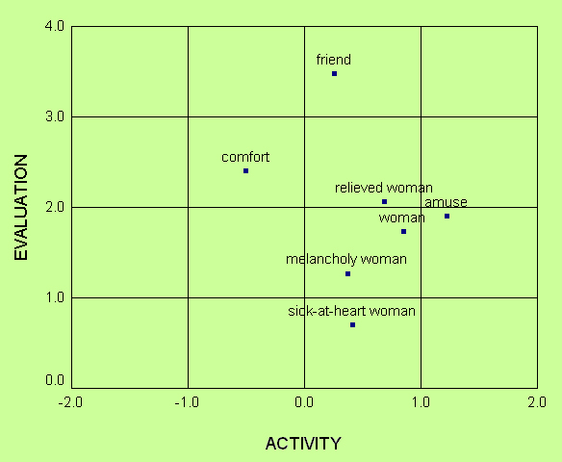
AIs in KMITL SIMs
5. อารมณ์ของตัวละคร ตามทฤษฎี Affect Theory Control
EPA profiles for "friend."
male: 2.66 1.81 0.92; female: 3.48 1.21 0.25
Z000000000 constant -0.25
Z100000000 Ae 0.44
Z010000000 Ap 0.00
Ae' = -0.25 + 0.44·Ae + 0.00·Ap + 0.01·Aa + 0.41·Be - 0.04·Bp - 0.10·Ba + 0.02·Oe - 0.02·Op - 0.01·Oa + 0.05·Ae·Be - 0.03·Ae·Bp + 0.00·Ae·Oe + 0.01·Ae·Op + 0.01·Ap·Be + 0.00·Ap·Bp + 0.02·Ap·Op - 0.01·Ap·Oa + 0.00·Aa·Ba + 0.13·Be·Oe - 0.06·Be·Op - 0.06·Bp·Oe + 0.07·Bp·Op + 0.01·Bp·Oa + 0.03·Ba·Op + 0.03·Ae·Be·Oe + 0.02·Ae·Bp·Op - 0.02·Ap·Bp·Op + 0.02·Ap·Bp·Oa

Slide 9
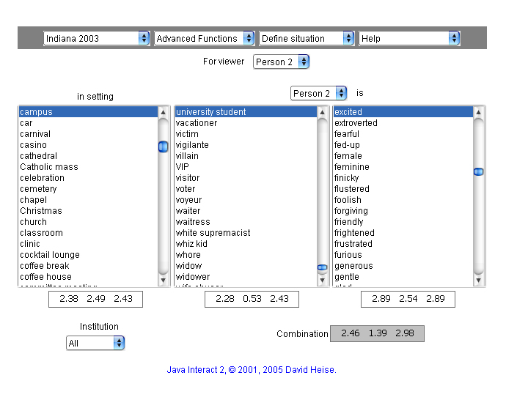
Interact

Slide 10
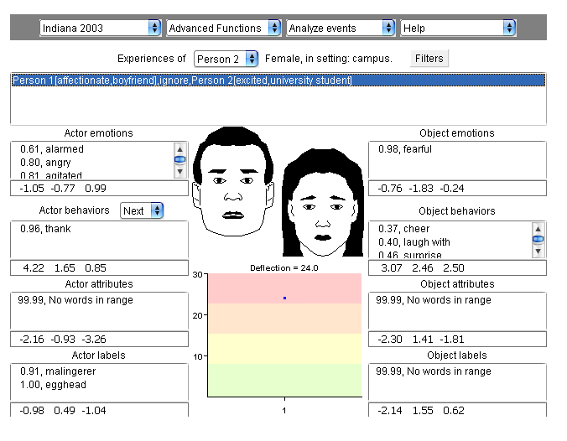
Interact

Slide 11
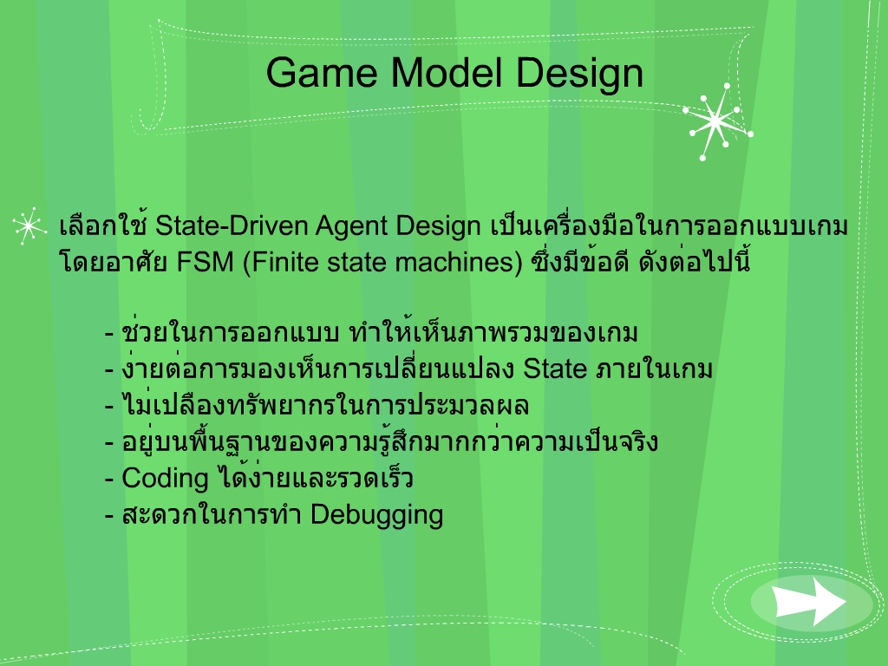
State – Driven Design

Slide 12
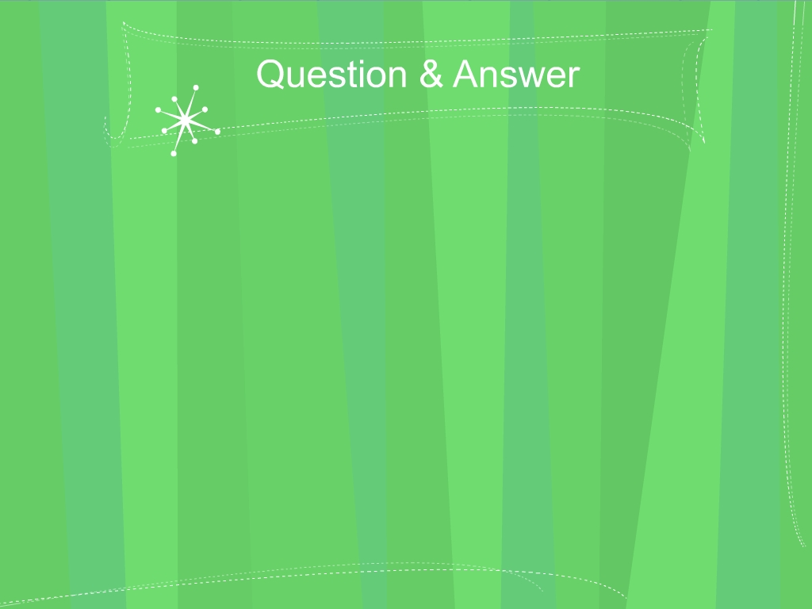
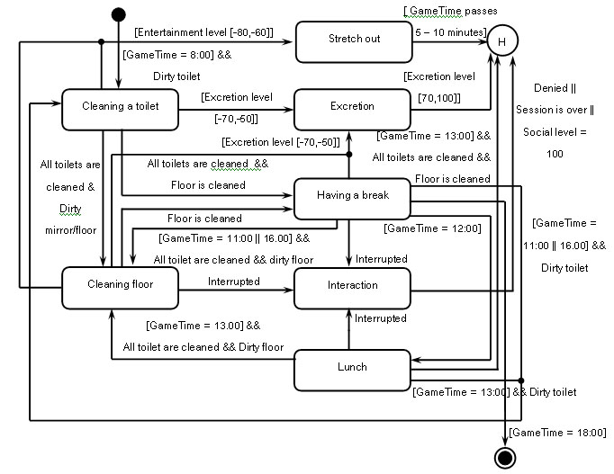

State Diagram : Maid

Slide 13
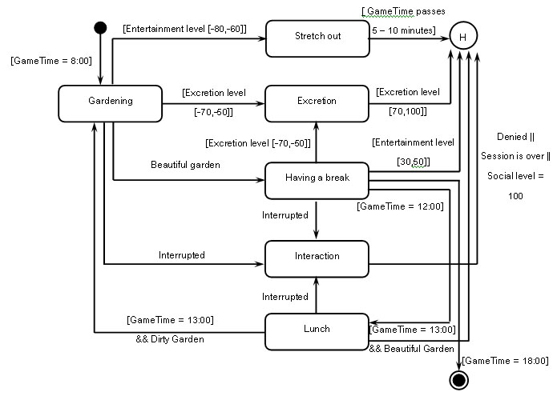
State Diagram : Gardener

Slide 14
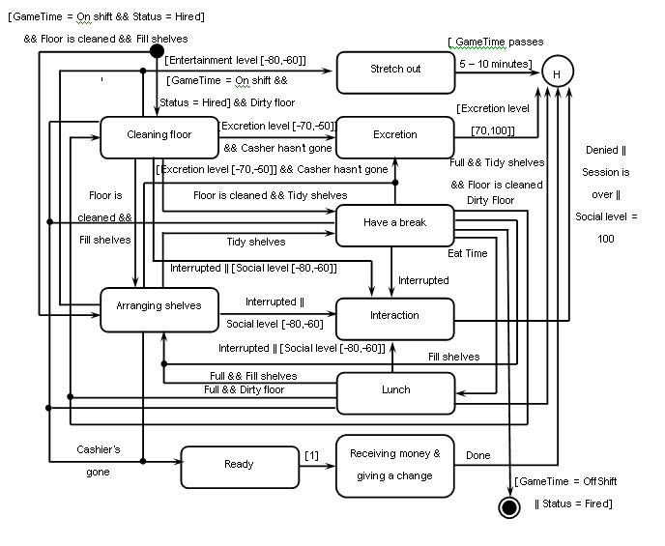
State Diagram : Shop Cleaner

Slide 15
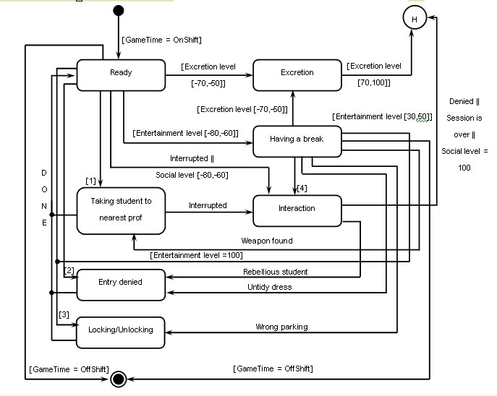
State Diagram : Unkind Guard

Slide 16
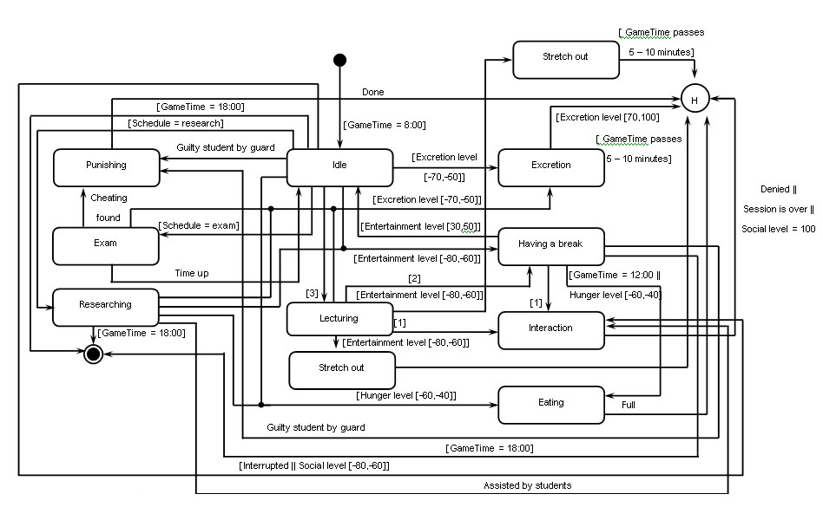
State Diagram : Genius Professor

Slide 17
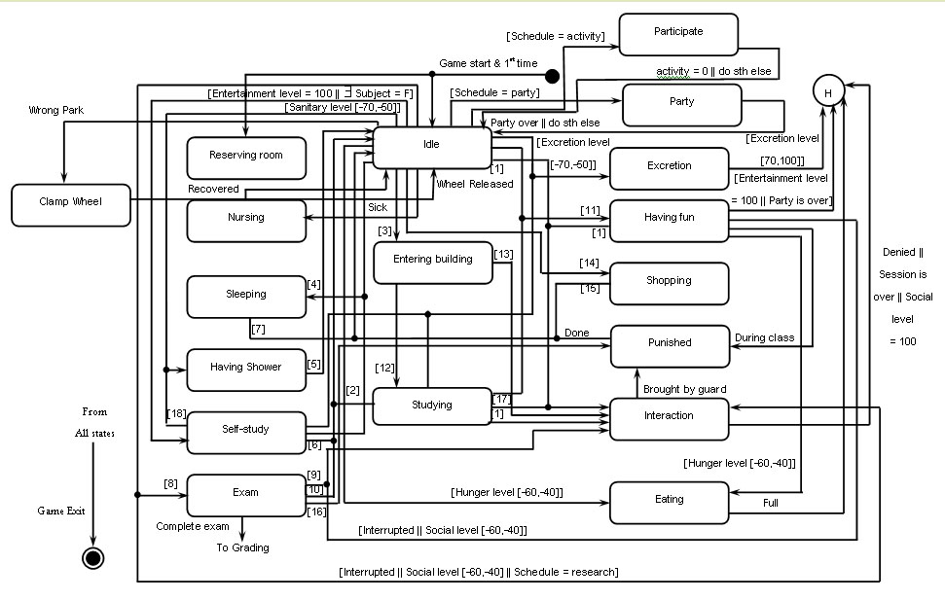
State Diagram : Student (Joker)

Slide 18
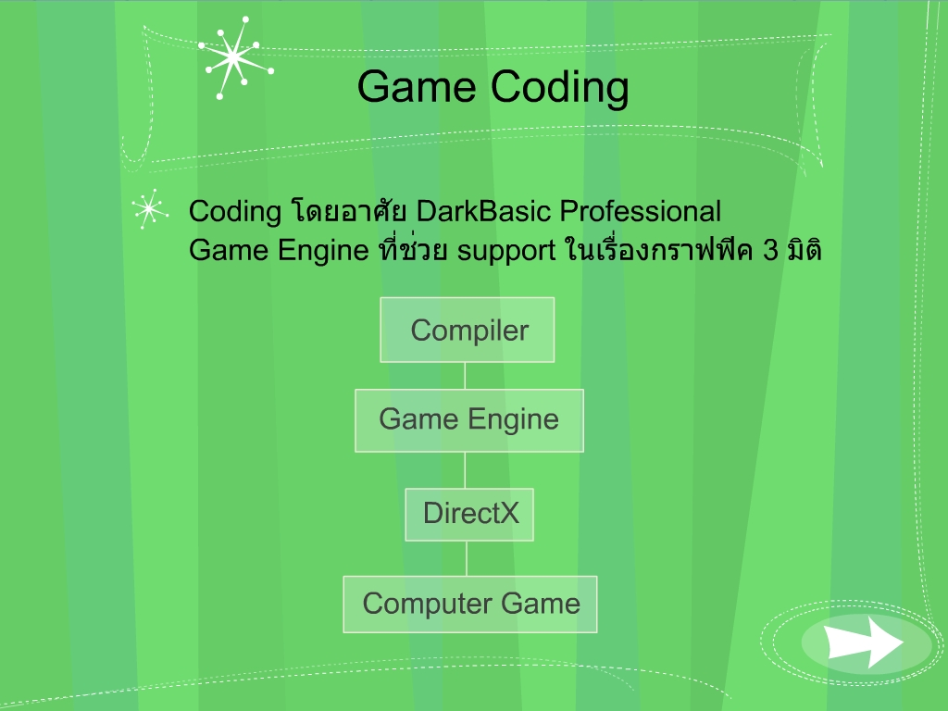
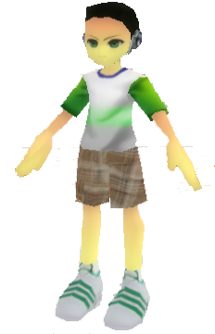

Slide 19
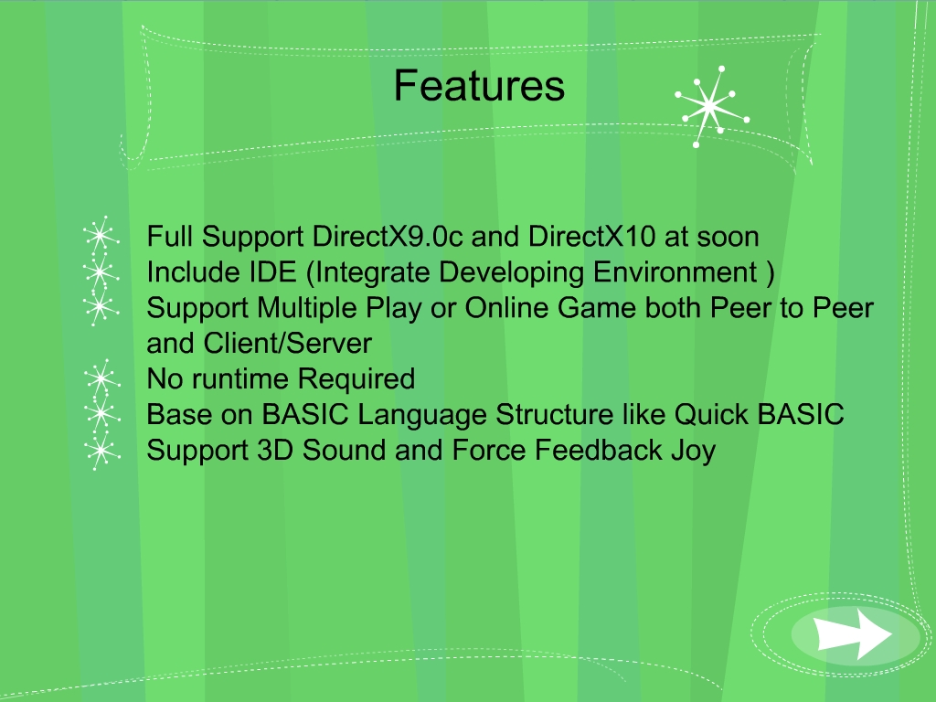

Slide 20
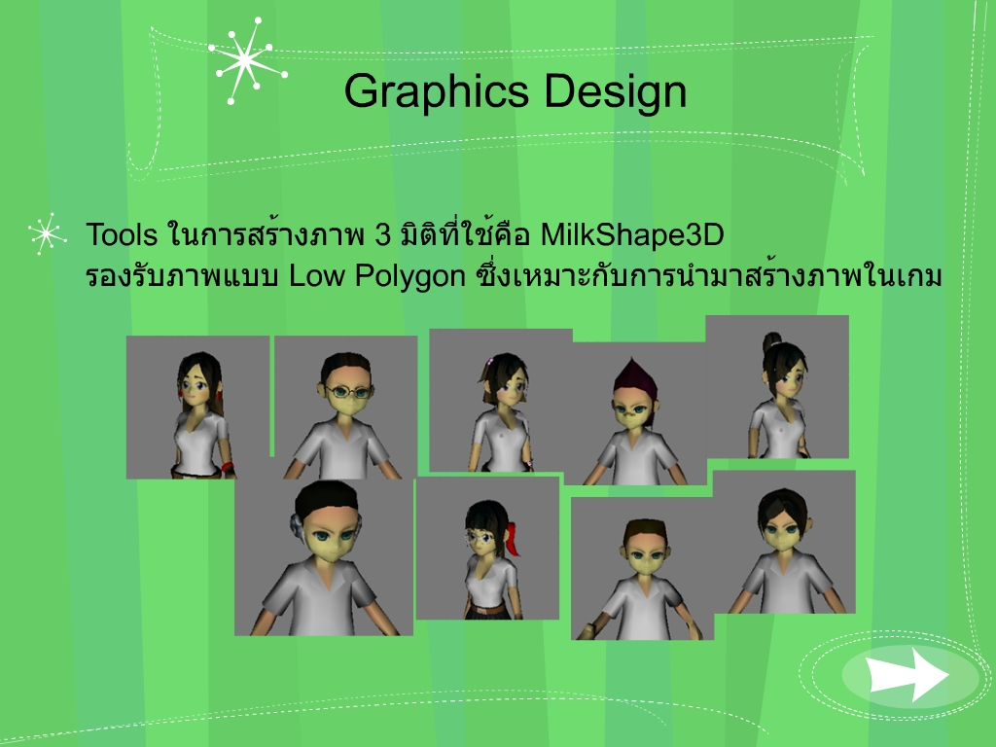

Slide 21
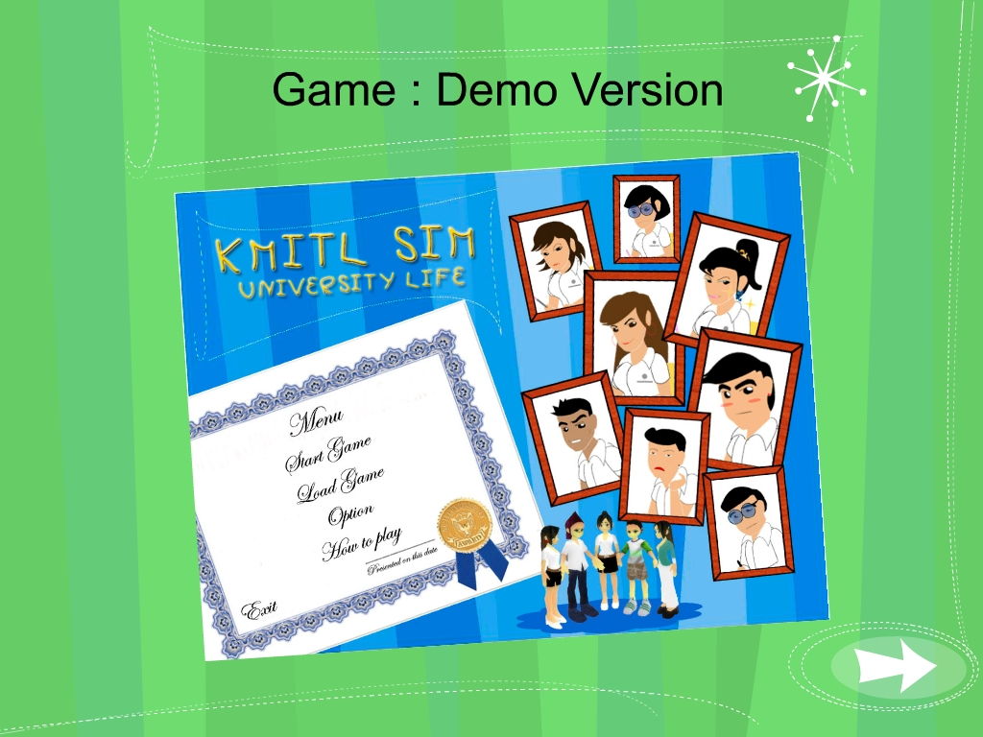

Slide 22
